Slide 1
Single-Row Functions
Notes:
Schedule: Timing Topic
55 minutes Lecture
30 minutes Practice
85 minutes Total

Slide 2
Objectives
After completing this lesson, you should be able to
do the following:
Describe various types of functions available
in SQL
Use character, number, and date functions in SELECT statements
Describe the use of conversion functions
Notes:
Lesson Aim
Functions make the basic query block more powerful and are used to manipulate data values. This is the first of two lessons that explore functions. It focuses on single-row character, number, and date functions, as well as those functions that convert data from one type to another, for example, character data to numeric data.

Slide 3
SQL Functions
Input
Function
Output
arg 1
Function performs action
arg 2
Result
value
arg n
Notes:
SQL Functions
Functions are a very powerful feature of SQL and can be used to do the following:
Perform calculations on data
Modify individual data items
Manipulate output for groups of rows
Format dates and numbers for display
Convert column data types
SQL functions sometimes take arguments and always return a value.
Note: Most of the functions described in this lesson are specific to Oracle’s version of SQL.
Instructor Note
This lesson does not discuss all functions in great detail. It presents the most common functions with a brief explanation of them.

Slide 4
Two Types of SQL Functions
Functions
Single-row
functions
Multiple-row
functions
Notes:
SQL Functions (continued)
There are two distinct types of functions:
Single-row functions
Multiple-row functions
Single-Row Functions
These functions operate on single rows only and return one result per row. There are different types of single-row functions. This lesson covers the following ones:
Character
Number
Date
Conversion
Multiple-Row Functions
Functions can manipulate groups of rows to give one result per group of rows. These functions are known as group functions. This is covered in a later lesson.
For more information, see Oracle9i SQL Reference for the complete list of available functions and their syntax.

Slide 5
Single-Row Functions
Single row functions:
Manipulate data items
Accept arguments and return one value
Act on each row returned
Return one result per row
May modify the data type
Can be nested
Accept arguments which can be a column or an expression
function_name [(arg1, arg2,...)]
Notes:
Single-Row Functions
Single-row functions are used to manipulate data items. They accept one or more arguments and return one value for each row returned by the query. An argument can be one of the following:
User-supplied constant
Variable value
Column name
Expression
Features of single-row functions include:
Acting on each row returned in the query
Returning one result per row
Possibly returning a data value of a different type than that referenced
Possibly expecting one or more arguments
Can be used in SELECT, WHERE, and ORDER BY clauses; can be nested
In the syntax:
function_name is the name of the function.
arg1, arg2 is any argument to be used by the function. This can be represented by a column name or expression.

Slide 6
Single-Row Functions
Character
General
Number
Single-row
functions
Conversion
Date
Notes:
Single-Row Functions (continued)
This lesson covers the following single-row functions:
Character functions: Αccept character input and can return both character and number values
Number functions: Accept numeric input and return numeric values
Date functions: Operate on values of the DATE data type (All date functions return a value of DATE data type except the MONTHS_BETWEEN function, which returns a number.)
Conversion functions: Convert a value from one data type to another
General functions:
NVL
NVL2
NULLIF
COALSECE
CASE
DECODE

Slide 7
Character Functions
Character
functions
Case-manipulation
functions
Character-manipulation
functions
Notes:
Character Functions
Single-row character functions accept character data as input and can return both character and numeric values. Character functions can be divided into the following:
Case-manipulation functions
Character-manipulation functions
Note: The functions discussed in this lesson are only some of the available functions.

Slide 8
Case Manipulation Functions
These functions convert case for character strings.
Function
Result
LOWER('SQL Course')
UPPER('SQL Course')
sql course
SQL COURSE
Notes:
Case Manipulation Functions
LOWER, UPPER, and INITCAP are the three case-conversion functions.
LOWER: Converts mixed case or uppercase character strings to lowercase
UPPER: Converts mixed case or lowercase character strings to uppercase
INITCAP: Converts the first letter of each word to uppercase and remaining letters to lowercase
SELECT 'The job id for '||UPPER(last_name)||' is '
||LOWER(job_id) AS "EMPLOYEE DETAILS"
FROM employees;
…

Slide 9
Case Manipulation Functions
These functions convert case for character strings.
Function
Result
INITCAP('SQL Course‘)
Sql Course
Notes:
Case Manipulation Functions
LOWER, UPPER, and INITCAP are the three case-conversion functions.
LOWER: Converts mixed case or uppercase character strings to lowercase
UPPER: Converts mixed case or lowercase character strings to uppercase
INITCAP: Converts the first letter of each word to uppercase and remaining letters to lowercase
SELECT 'The job id for '||UPPER(last_name)||' is '
||LOWER(job_id) AS "EMPLOYEE DETAILS"
FROM employees;
…

Slide 10
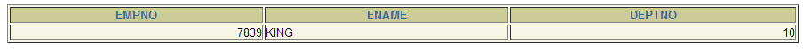
Using Case Manipulation Functions
Display the employee number, name, and department number for employee Higgins:
SELECT empno, ename, deptno
FROM emp
WHERE ename = ‘king';
no rows selected
SELECT empno, ename, deptno
FROM emp
WHERE LOWER(ename) = ‘king';
Notes:
Case Manipulation Functions (continued)
The slide example displays the employee number, name, and department number of employee Higgins.
The WHERE clause of the first SQL statement specifies the employee name as higgins. Because all the data in the EMPLOYEES table is stored in proper case, the name higgins does not find a match in the table, and no rows are selected.
The WHERE clause of the second SQL statement specifies that the employee name in the EMPLOYEES table is compared to higgins, converting the LAST_NAME column to lowercase for comparison purposes. Since both names are lowercase now, a match is found and one row is selected. The WHERE clause can be rewritten in the following manner to produce the same result:
...WHERE last_name = 'Higgins'
The name in the output appears as it was stored in the database. To display the name capitalized, use the UPPER function in the SELECT statement.
SELECT employee_id, UPPER(last_name), department_id
FROM employees
WHERE INITCAP(last_name) = 'Higgins';

Slide 11
Character-Manipulation Functions
These functions manipulate character strings:
Function
Result
CONCAT('Hello', 'World')
SUBSTR('HelloWorld',1,5)
LENGTH('HelloWorld')
INSTR('HelloWorld', 'W')
LPAD(salary,10,'*')
RPAD(salary, 10, '*')
TRIM('H' FROM 'HelloWorld')
HelloWorld
Hello
10
6
*****24000
24000*****
elloWorld
Notes:
Character Manipulation Functions
CONCAT, SUBSTR, LENGTH, INSTR, LPAD, RPAD, and TRIM are the character manipulation functions covered in this lesson.
CONCAT: Joins values together (You are limited to using two parameters with CONCAT.)
SUBSTR: Extracts a string of determined length
LENGTH: Shows the length of a string as a numeric value
INSTR: Finds numeric position of a named character
LPAD: Pads the character value right-justified
RPAD: Pads the character value left-justified
TRIM: Trims heading or trailing characters (or both) from a character string (If trim_character or trim_source is a character literal, you must enclose it in single quotes.)
Instructor Note
Be sure to point out RPAD to the students, because this function is needed in a practice exercise. Also, TRIM, which was a new function in Oracle8i, does the job of both the LTRIM and the RTRIM functions.

Slide 12
Character-Manipulation Functions
CONCATINATION FUNCTION:
Function
Result
CONCAT('Hello', 'World‘)
HelloWorld
Notes:
Character Manipulation Functions
CONCAT, SUBSTR, LENGTH, INSTR, LPAD, RPAD, and TRIM are the character manipulation functions covered in this lesson.
CONCAT: Joins values together (You are limited to using two parameters with CONCAT.)
SUBSTR: Extracts a string of determined length
LENGTH: Shows the length of a string as a numeric value
INSTR: Finds numeric position of a named character
LPAD: Pads the character value right-justified
RPAD: Pads the character value left-justified
TRIM: Trims heading or trailing characters (or both) from a character string (If trim_character or trim_source is a character literal, you must enclose it in single quotes.)
Instructor Note
Be sure to point out RPAD to the students, because this function is needed in a practice exercise. Also, TRIM, which was a new function in Oracle8i, does the job of both the LTRIM and the RTRIM functions.

Slide 13
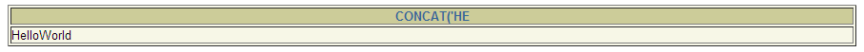
Character-Manipulation Functions
CONCATINATION FUNCTION:
SELECT CONCAT(‘Hello’,’World’)
FROM dual;
DUAL is a dummy table you can use to view results
from functions and calculations.
Notes:
Character Manipulation Functions
CONCAT, SUBSTR, LENGTH, INSTR, LPAD, RPAD, and TRIM are the character manipulation functions covered in this lesson.
CONCAT: Joins values together (You are limited to using two parameters with CONCAT.)
SUBSTR: Extracts a string of determined length
LENGTH: Shows the length of a string as a numeric value
INSTR: Finds numeric position of a named character
LPAD: Pads the character value right-justified
RPAD: Pads the character value left-justified
TRIM: Trims heading or trailing characters (or both) from a character string (If trim_character or trim_source is a character literal, you must enclose it in single quotes.)
Instructor Note
Be sure to point out RPAD to the students, because this function is needed in a practice exercise. Also, TRIM, which was a new function in Oracle8i, does the job of both the LTRIM and the RTRIM functions.

Slide 14
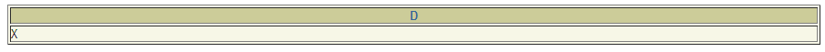
DUAL Table
It is owned by the user SYS and can be accessed by all users. It contains one column, DUMMY, and one row value X.
SELECT *
FROM dual;

Slide 15
DUAL Table
The dual table is useful when you want to return a value once only, for instance, the value of a constant, or expression that is not derived from a table with user data.
It is generally used for SELECT clause syntax completeness only,
SELECT *
FROM dual;

Slide 16
Character-Manipulation Functions
SUBSTR FUNCTION:
Function
Result
SUBSTR('HelloWorld', 1,5)
Hello
Notes:
Character Manipulation Functions
CONCAT, SUBSTR, LENGTH, INSTR, LPAD, RPAD, and TRIM are the character manipulation functions covered in this lesson.
CONCAT: Joins values together (You are limited to using two parameters with CONCAT.)
SUBSTR: Extracts a string of determined length
LENGTH: Shows the length of a string as a numeric value
INSTR: Finds numeric position of a named character
LPAD: Pads the character value right-justified
RPAD: Pads the character value left-justified
TRIM: Trims heading or trailing characters (or both) from a character string (If trim_character or trim_source is a character literal, you must enclose it in single quotes.)
Instructor Note
Be sure to point out RPAD to the students, because this function is needed in a practice exercise. Also, TRIM, which was a new function in Oracle8i, does the job of both the LTRIM and the RTRIM functions.

Slide 17
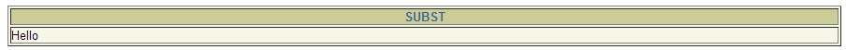
Character-Manipulation Functions
SUBSTR FUNCTION:
SELECT SUBSTR(‘HelloWorld’,1,5)
FROM dual;
Notes:
Character Manipulation Functions
CONCAT, SUBSTR, LENGTH, INSTR, LPAD, RPAD, and TRIM are the character manipulation functions covered in this lesson.
CONCAT: Joins values together (You are limited to using two parameters with CONCAT.)
SUBSTR: Extracts a string of determined length
LENGTH: Shows the length of a string as a numeric value
INSTR: Finds numeric position of a named character
LPAD: Pads the character value right-justified
RPAD: Pads the character value left-justified
TRIM: Trims heading or trailing characters (or both) from a character string (If trim_character or trim_source is a character literal, you must enclose it in single quotes.)
Instructor Note
Be sure to point out RPAD to the students, because this function is needed in a practice exercise. Also, TRIM, which was a new function in Oracle8i, does the job of both the LTRIM and the RTRIM functions.

Slide 18
Character-Manipulation Functions
LENGTH FUNCTION:
Function
Result
LENGTH('HelloWorld')
10
Notes:
Character Manipulation Functions
CONCAT, SUBSTR, LENGTH, INSTR, LPAD, RPAD, and TRIM are the character manipulation functions covered in this lesson.
CONCAT: Joins values together (You are limited to using two parameters with CONCAT.)
SUBSTR: Extracts a string of determined length
LENGTH: Shows the length of a string as a numeric value
INSTR: Finds numeric position of a named character
LPAD: Pads the character value right-justified
RPAD: Pads the character value left-justified
TRIM: Trims heading or trailing characters (or both) from a character string (If trim_character or trim_source is a character literal, you must enclose it in single quotes.)
Instructor Note
Be sure to point out RPAD to the students, because this function is needed in a practice exercise. Also, TRIM, which was a new function in Oracle8i, does the job of both the LTRIM and the RTRIM functions.

Slide 19

Character-Manipulation Functions
LENGTH FUNCTION:
SELECT LENGTH(‘HelloWorld’)
FROM dual;
Notes:
Character Manipulation Functions
CONCAT, SUBSTR, LENGTH, INSTR, LPAD, RPAD, and TRIM are the character manipulation functions covered in this lesson.
CONCAT: Joins values together (You are limited to using two parameters with CONCAT.)
SUBSTR: Extracts a string of determined length
LENGTH: Shows the length of a string as a numeric value
INSTR: Finds numeric position of a named character
LPAD: Pads the character value right-justified
RPAD: Pads the character value left-justified
TRIM: Trims heading or trailing characters (or both) from a character string (If trim_character or trim_source is a character literal, you must enclose it in single quotes.)
Instructor Note
Be sure to point out RPAD to the students, because this function is needed in a practice exercise. Also, TRIM, which was a new function in Oracle8i, does the job of both the LTRIM and the RTRIM functions.

Slide 20
Character-Manipulation Functions
INSTR FUNCTION:
Function
Result
INSTR('HelloWorld‘,’W’)
6
Notes:
Character Manipulation Functions
CONCAT, SUBSTR, LENGTH, INSTR, LPAD, RPAD, and TRIM are the character manipulation functions covered in this lesson.
CONCAT: Joins values together (You are limited to using two parameters with CONCAT.)
SUBSTR: Extracts a string of determined length
LENGTH: Shows the length of a string as a numeric value
INSTR: Finds numeric position of a named character
LPAD: Pads the character value right-justified
RPAD: Pads the character value left-justified
TRIM: Trims heading or trailing characters (or both) from a character string (If trim_character or trim_source is a character literal, you must enclose it in single quotes.)
Instructor Note
Be sure to point out RPAD to the students, because this function is needed in a practice exercise. Also, TRIM, which was a new function in Oracle8i, does the job of both the LTRIM and the RTRIM functions.

Slide 21

Character-Manipulation Functions
INSTR FUNCTION:
SELECT INSTR(‘HelloWorld’,’W’)
FROM dual;
Notes:
Character Manipulation Functions
CONCAT, SUBSTR, LENGTH, INSTR, LPAD, RPAD, and TRIM are the character manipulation functions covered in this lesson.
CONCAT: Joins values together (You are limited to using two parameters with CONCAT.)
SUBSTR: Extracts a string of determined length
LENGTH: Shows the length of a string as a numeric value
INSTR: Finds numeric position of a named character
LPAD: Pads the character value right-justified
RPAD: Pads the character value left-justified
TRIM: Trims heading or trailing characters (or both) from a character string (If trim_character or trim_source is a character literal, you must enclose it in single quotes.)
Instructor Note
Be sure to point out RPAD to the students, because this function is needed in a practice exercise. Also, TRIM, which was a new function in Oracle8i, does the job of both the LTRIM and the RTRIM functions.

Slide 22
Character-Manipulation Functions
LPAD FUNCTION:
Function
Result
LPAD(sal,10,’*’)
*****24000
Notes:
Character Manipulation Functions
CONCAT, SUBSTR, LENGTH, INSTR, LPAD, RPAD, and TRIM are the character manipulation functions covered in this lesson.
CONCAT: Joins values together (You are limited to using two parameters with CONCAT.)
SUBSTR: Extracts a string of determined length
LENGTH: Shows the length of a string as a numeric value
INSTR: Finds numeric position of a named character
LPAD: Pads the character value right-justified
RPAD: Pads the character value left-justified
TRIM: Trims heading or trailing characters (or both) from a character string (If trim_character or trim_source is a character literal, you must enclose it in single quotes.)
Instructor Note
Be sure to point out RPAD to the students, because this function is needed in a practice exercise. Also, TRIM, which was a new function in Oracle8i, does the job of both the LTRIM and the RTRIM functions.

Slide 23
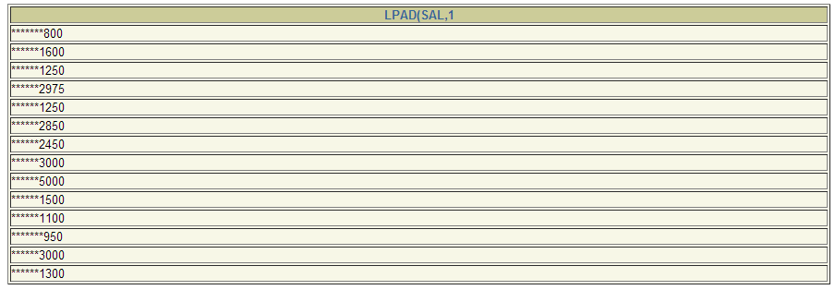
Character-Manipulation Functions
LPAD FUNCTION:
SELECT LPAD(sal, 10, ‘*’)
FROM emp;
Notes:
Character Manipulation Functions
CONCAT, SUBSTR, LENGTH, INSTR, LPAD, RPAD, and TRIM are the character manipulation functions covered in this lesson.
CONCAT: Joins values together (You are limited to using two parameters with CONCAT.)
SUBSTR: Extracts a string of determined length
LENGTH: Shows the length of a string as a numeric value
INSTR: Finds numeric position of a named character
LPAD: Pads the character value right-justified
RPAD: Pads the character value left-justified
TRIM: Trims heading or trailing characters (or both) from a character string (If trim_character or trim_source is a character literal, you must enclose it in single quotes.)
Instructor Note
Be sure to point out RPAD to the students, because this function is needed in a practice exercise. Also, TRIM, which was a new function in Oracle8i, does the job of both the LTRIM and the RTRIM functions.

Slide 24
Character-Manipulation Functions
RPAD FUNCTION:
Function
Result
RPAD(sal,10,’*’)
24000*****
Notes:
Character Manipulation Functions
CONCAT, SUBSTR, LENGTH, INSTR, LPAD, RPAD, and TRIM are the character manipulation functions covered in this lesson.
CONCAT: Joins values together (You are limited to using two parameters with CONCAT.)
SUBSTR: Extracts a string of determined length
LENGTH: Shows the length of a string as a numeric value
INSTR: Finds numeric position of a named character
LPAD: Pads the character value right-justified
RPAD: Pads the character value left-justified
TRIM: Trims heading or trailing characters (or both) from a character string (If trim_character or trim_source is a character literal, you must enclose it in single quotes.)
Instructor Note
Be sure to point out RPAD to the students, because this function is needed in a practice exercise. Also, TRIM, which was a new function in Oracle8i, does the job of both the LTRIM and the RTRIM functions.

Slide 25
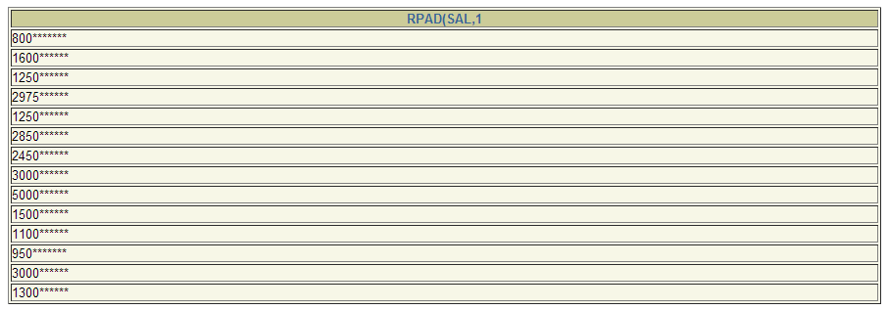
Character-Manipulation Functions
RPAD FUNCTION:
SELECT RPAD(sal, 10, ‘*’)
FROM emp;
Notes:
Character Manipulation Functions
CONCAT, SUBSTR, LENGTH, INSTR, LPAD, RPAD, and TRIM are the character manipulation functions covered in this lesson.
CONCAT: Joins values together (You are limited to using two parameters with CONCAT.)
SUBSTR: Extracts a string of determined length
LENGTH: Shows the length of a string as a numeric value
INSTR: Finds numeric position of a named character
LPAD: Pads the character value right-justified
RPAD: Pads the character value left-justified
TRIM: Trims heading or trailing characters (or both) from a character string (If trim_character or trim_source is a character literal, you must enclose it in single quotes.)
Instructor Note
Be sure to point out RPAD to the students, because this function is needed in a practice exercise. Also, TRIM, which was a new function in Oracle8i, does the job of both the LTRIM and the RTRIM functions.

Slide 26
Character-Manipulation Functions
TRIM FUNCTION:
Function
Result
TRIM(‘H’ FROM ‘HELLOWORLD’)
ELLOWORLD
Notes:
Character Manipulation Functions
CONCAT, SUBSTR, LENGTH, INSTR, LPAD, RPAD, and TRIM are the character manipulation functions covered in this lesson.
CONCAT: Joins values together (You are limited to using two parameters with CONCAT.)
SUBSTR: Extracts a string of determined length
LENGTH: Shows the length of a string as a numeric value
INSTR: Finds numeric position of a named character
LPAD: Pads the character value right-justified
RPAD: Pads the character value left-justified
TRIM: Trims heading or trailing characters (or both) from a character string (If trim_character or trim_source is a character literal, you must enclose it in single quotes.)
Instructor Note
Be sure to point out RPAD to the students, because this function is needed in a practice exercise. Also, TRIM, which was a new function in Oracle8i, does the job of both the LTRIM and the RTRIM functions.

Slide 27
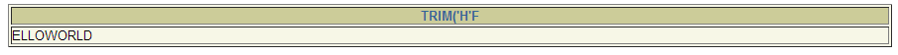
Character-Manipulation Functions
TRIM FUNCTION:
SELECT TRIM(‘H’ FROM ‘HELLOWORLD’)
FROM dual;
Notes:
Character Manipulation Functions
CONCAT, SUBSTR, LENGTH, INSTR, LPAD, RPAD, and TRIM are the character manipulation functions covered in this lesson.
CONCAT: Joins values together (You are limited to using two parameters with CONCAT.)
SUBSTR: Extracts a string of determined length
LENGTH: Shows the length of a string as a numeric value
INSTR: Finds numeric position of a named character
LPAD: Pads the character value right-justified
RPAD: Pads the character value left-justified
TRIM: Trims heading or trailing characters (or both) from a character string (If trim_character or trim_source is a character literal, you must enclose it in single quotes.)
Instructor Note
Be sure to point out RPAD to the students, because this function is needed in a practice exercise. Also, TRIM, which was a new function in Oracle8i, does the job of both the LTRIM and the RTRIM functions.

Slide 28
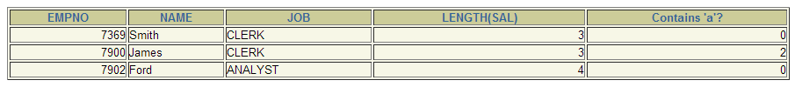
Using the Character-Manipulation Functions
1
SELECT empno, INITCAP(ename) NAME,
job, LENGTH(sal),
INSTR(ename, 'A') "Contains 'a'?"
FROM emp
WHERE SUBSTR(hiredate, 4,3) = 'DEC';
2
3
1
2
3
Notes:
Character-Manipulation Functions (continued)
The slide example displays employee first names and last names joined together, the length of the employee last name, and the numeric position of the letter a in the employee last name for all employees who have the string REP contained in the job ID starting at the fourth position of the job ID.
Example
Modify the SQL statement on the slide to display the data for those employees whose last names end with an n.
SELECT employee_id, CONCAT(first_name, last_name) NAME,
LENGTH (last_name), INSTR(last_name, 'a') "Contains 'a'?"
FROM employees
WHERE SUBSTR(last_name, -1, 1) = 'n';

Slide 29
Character Manipulation Functions
CONCAT: Joins values together (You are limited to using two parameters with CONCAT)
SUBSTR: Extracts a string of determined length
LENGTH: Shows the length of a string as a numeric value
INSTR: Finds the numeric position of a named character
LPAD: Pads the character value right-justified
RPAD: Pads the character value left-justified
TRIM: Trims heading or trailing characters (or both) from a character string

Slide 30
Number Functions
Number Functions accepts numeric input and return numeric values.
Notes:
Number Functions
Number functions accept numeric input and return numeric values. This section describes some of the number functions.
Note: This list contains only some of the available number functions.
For more information, see Oracle9i SQL Reference, “Number Functions.”

Slide 31
Number Functions
ROUND: Rounds value to specified decimal
    ROUND(45.926, 2) 45.93
TRUNC: Truncates value to specified decimal
    TRUNC(45.926, 2) 45.92
MOD: Returns remainder of division
    MOD(1600, 300) 100
Notes:
Number Functions
Number functions accept numeric input and return numeric values. This section describes some of the number functions.
Note: This list contains only some of the available number functions.
For more information, see Oracle9i SQL Reference, “Number Functions.”

Slide 32
Using the ROUND Function
1
2
SELECT ROUND(45.923,2), ROUND(45.923,0),
ROUND(45.923,-1)
FROM DUAL;
3
1
2
3
Notes:
ROUND Function
The ROUND function rounds the column, expression, or value to n decimal places. If the second argument is 0 or is missing, the value is rounded to zero decimal places. If the second argument is 2, the value is rounded to two decimal places. Conversely, if the second argument is -2, the value is rounded to two decimal places to the left.
The ROUND function can also be used with date functions. You will see examples later in this lesson.
The DUAL Table
The DUAL table is owned by the user SYS and can be accessed by all users. It contains one column, DUMMY, and one row with the value X. The DUAL table is useful when you want to return a value once only, for instance, the value of a constant, pseudocolumn, or expression that is not derived from a table with user data. The DUAL table is generally used for SELECT clause syntax completeness, because both SELECT and FROM clauses are mandatory, and several calculations do not need to select from actual tables.

Slide 33
Round Function
It rounds the column, expression, or value to n decimal places.
If the second argument is zero or is missing, the value is rounded to zero decimal places.

Slide 34
Using the TRUNC Function
1
2
SELECT TRUNC(45.923,2), TRUNC(45.923),
TRUNC(45.923,-2)
FROM DUAL;
3
1
2
3
Notes:
TRUNC Function
The TRUNC function truncates the column, expression, or value to n decimal places.
The TRUNC function works with arguments similar to those of the ROUND function. If the second argument is 0 or is missing, the value is truncated to zero decimal places. If the second argument is 2, the value is truncated to two decimal places. Conversely, if the second argument is -2, the value is truncated to two decimal places to the left.
Like the ROUND function, the TRUNC function can be used with date functions.

Slide 35
Trunc Function
It truncates the column, expression, or value to n decimal places.
The trunc function works with arguments similar to those of the Round function.
TRUNC and ROUND functions can be used with date functions.

Slide 36
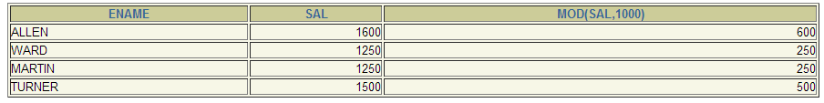
Using the MOD Function
Calculate the remainder of a salary after it is divided by 1000 for all employees whose job title is sales SALESMAN
SELECT ename, sal, MOD(sal, 1000)
FROM emp
WHERE job = 'SALESMAN';
Notes:
MOD Function
The MOD function finds the remainder of value1 divided by value2. The slide example calculates the remainder of the salary after dividing it by 5,000 for all employees whose job ID is SA_REP.
Note: The MOD function is often used to determine if a value is odd or even.
Instructor Note (for page 3-17)
You can change the default date display setting for a user session by executing the command:
ALTER SESSION SET NLS_DATE_FORMAT = 'date format model';
The DBA can set the date format for a database to a different format from the default. In either case, changing these settings is usually not a developer’s role.

Slide 37
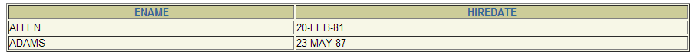
Working with Dates
Oracle database stores dates in an internal numeric format: century, year, month, day, hours, minutes, seconds.
The default date display format is DD-MON-RR.
  Allows you to store 21st century dates in the 20th century by specifying only the last two digits of the year.
  Allows you to store 20th century dates in the 21st century in the same way.
SELECT ename, hiredate
FROM emp
WHERE ename like ‘A%';
Notes:
Oracle Date Format
Oracle database stores dates in an internal numeric format, representing the century, year, month, day, hours, minutes, and seconds.
The default display and input format for any date is DD-MON-RR. Valid Oracle dates are between January 1, 4712 B.C. and December 31, 9999 A.D.
In the example in the slide, the HIRE_DATE for the employee Gietz is displayed in the default format DD-MON-RR. However, dates are not stored in the database in this format. All the components of the date and time are stored. So, although a HIRE_DATE such as 07-JUN-94 is displayed as day, month, and year, there is also time and century information associated with it. The complete data might be June 7th, 1994 5:10:43 p.m.
This data is stored internally as follows:
CENTURY YEAR MONTH DAY HOUR MINUTE SECOND
19 94 06 07 5 10 43
Centuries and the Year 2000
The Oracle server is year 2000 compliant. When a record with a date column is inserted into a table, the century information is picked up from the SYSDATE function. However, when the date column is displayed on the screen, the century component is not displayed by default.
The DATE data type always stores year information as a four-digit number internally: two digits for the century and two digits for the year. For example, the Oracle database stores the year as 1996 or 2001, and not just as 96 or 01.

Slide 38
Working with Dates
SYSDATE is a function that returns:
Date
Time
Notes:
The SYSDATE Function
SYSDATE is a date function that returns the current database server date and time. You can use SYSDATE just as you would use any other column name. For example, you can display the current date by selecting SYSDATE from a table. It is customary to select SYSDATE from a dummy table called DUAL.
Example
Display the current date using the DUAL table.
SELECT SYSDATE
FROM DUAL;

Slide 39
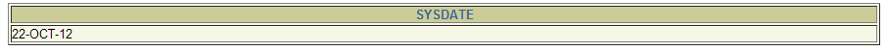
Working with Dates
SYSDATE is a function that returns:
SELECT SYSDATE
FROM dual;
Notes:
The SYSDATE Function
SYSDATE is a date function that returns the current database server date and time. You can use SYSDATE just as you would use any other column name. For example, you can display the current date by selecting SYSDATE from a table. It is customary to select SYSDATE from a dummy table called DUAL.
Example
Display the current date using the DUAL table.
SELECT SYSDATE
FROM DUAL;

Slide 40
Arithmetic with Dates
Add or subtract a number to or from a date for a resultant date value.
Subtract two dates to find the number of days between those dates.
Add hours to a date by dividing the number of hours by 24.
Notes:
Arithmetic with Dates
Since the database stores dates as numbers, you can perform calculations using arithmetic operators such as addition and subtraction. You can add and subtract number constants as well as dates.
You can perform the following operations:

Slide 41
Arithmetic with Dates
Operation | Result | Description
Date + number | Date | Adds a number of days to a date
Date – number | Date | Subtracts a number of days from a date
Date – date | Number of Days | Subtracts one date from another
Date + number/24 | Date | Adds a number of hours to a date

Slide 42
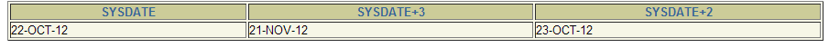
Arithmetic with Dates
SELECT SYSDATE, SYSDATE + 30, SYSDATE + 22/24
FROM dual;

Slide 43
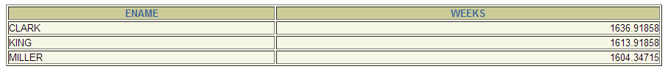
Using Arithmetic Operators with Dates
SELECT ename, (SYSDATE-hiredate)/7 AS WEEKS
FROM emp
WHERE deptno = 10;
Notes:
Arithmetic with Dates (continued)
The example on the slide displays the last name and the number of weeks employed for all employees in department 90. It subtracts the date on which the employee was hired from the current date (SYSDATE) and divides the result by 7 to calculate the number of weeks that a worker has been employed.
Note: SYSDATE is a SQL function that returns the current date and time. Your results may differ from the example.
If a more current date is subtracted from an older date, the difference is a negative number.

Slide 44
Date Functions
Function
Description
MONTHS_BETWEEN
Number of months
between two dates
ADD_MONTHS
Add calendar months to date
NEXT_DAY
Next day of the date specified
LAST_DAY
Last day of the month
ROUND
Round date
TRUNC
Truncate date
Notes:
Date Functions
Date functions operate on Oracle dates. All date functions return a value of DATE data type except MONTHS_BETWEEN, which returns a numeric value.
MONTHS_BETWEEN(date1, date2): Finds the number of months between date1 and date2. The result can be positive or negative. If date1 is later than date2, the result is positive; if date1 is earlier than date2, the result is negative. The noninteger part of the result represents a portion of the month.
ADD_MONTHS(date, n): Adds n number of calendar months to date. The value of n must be an integer and can be negative.
NEXT_DAY(date, 'char'): Finds the date of the next specified day of the week ('char') following date. The value of char may be a number representing a day or a character string.
LAST_DAY(date): Finds the date of the last day of the month that contains date.
ROUND(date[,'fmt']): Returns date rounded to the unit specified by the format model fmt. If the format model fmt is omitted, date is rounded to the nearest day.
TRUNC(date[, 'fmt']): Returns date with the time portion of the day truncated to the unit specified by the format model fmt. If the format model fmt is omitted, date is truncated to the nearest day.
This list is a subset of the available date functions. The format models are covered later in this lesson. Examples of format models are month and year.

Slide 45
Using Date Functions
MONTHS_BETWEEN ('01-SEP-95','11-JAN-94')
19.6774194
ADD_MONTHS ('11-JAN-94',6)
'11-JUL-94'
NEXT_DAY ('01-SEP-95','FRIDAY')
'08-SEP-95'
LAST_DAY('01-FEB-95')
'28-FEB-95'
Notes:
Date Functions (continued)
For example, display the employee number, hire date, number of months employed, six-month review date, first Friday after hire date, and last day of the hire month for all employees employed for fewer than 36 months.
SELECT employee_id, hire_date,
MONTHS_BETWEEN (SYSDATE, hire_date) TENURE,
ADD_MONTHS (hire_date, 6) REVIEW,
NEXT_DAY (hire_date, 'FRIDAY'), LAST_DAY(hire_date)
FROM employees
WHERE MONTHS_BETWEEN (SYSDATE, hire_date) < 36;

Slide 46
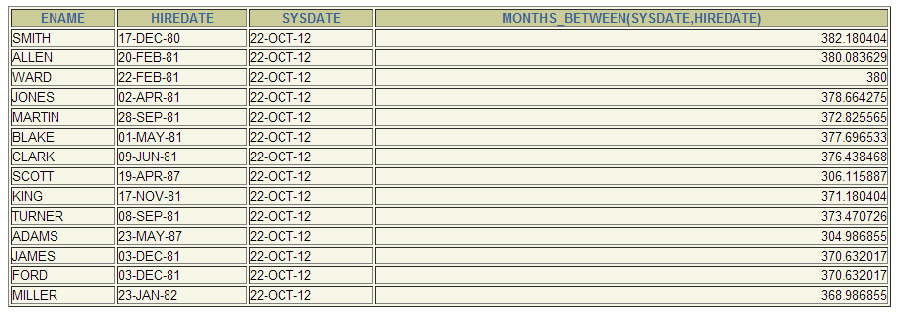
Date Function
MONTHS_BETWEEN
SELECT ename, hiredate, SYSDATE,
MONTHS_BETWEEN(SYSDATE, hiredate)
FROM emp;

Slide 47
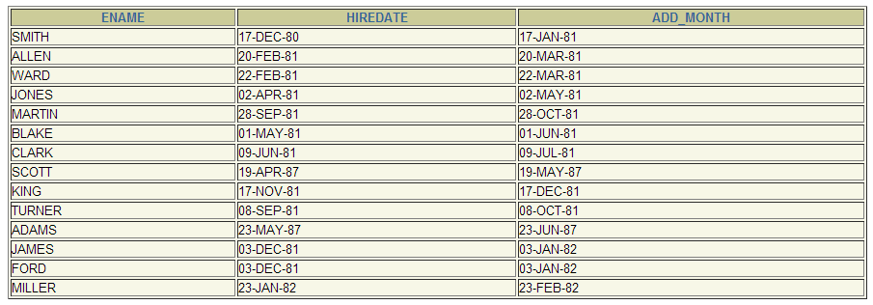
Date Function
ADD_MONTHS
SELECT ename, hiredate,
ADD_MONTHS(hiredate,1)
FROM emp;

Slide 48
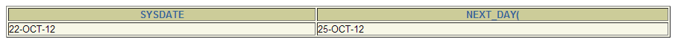
Date Function
ADD_MONTHS
SELECT SYSDATE, NEXT_DAY(SYSDATE, 'THURSDAY')
FROM dual;

Slide 49
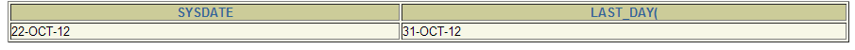
Date Function
ADD_MONTHS
SELECT SYSDATE, LAST_DAY(SYSDATE)
FROM dual;

Slide 50
Using Date Functions
Assume SYSDATE = '25-JUL-95':
ROUND(SYSDATE,'MONTH') 01-AUG-95
ROUND(SYSDATE ,'YEAR') 01-JAN-96
TRUNC(SYSDATE ,'MONTH') 01-JUL-95
TRUNC(SYSDATE ,'YEAR') 01-JAN-95
Notes:
Date Functions (continued)
The ROUND and TRUNC functions can be used for number and date values. When used with dates, these functions round or truncate to the specified format model. Therefore, you can round dates to the nearest year or month.
Example
Compare the hire dates for all employees who started in 1997. Display the employee number, hire date, and start month using the ROUND and TRUNC functions.
SELECT employee_id, hire_date,
ROUND(hire_date, 'MONTH'), TRUNC(hire_date, 'MONTH')
FROM employees
WHERE hire_date LIKE '%97';
Instructor Note
If the format model is month, dates 1-15 result in the first day of the current month. Dates 16-31 result in the first day of the next month. If the format model is year, months 1-6 result with January 1st of the current year. Months 7-12 result in January 1st of the next year.
This is a good point to break the lesson in half. Have the students do Practice 3 - Part 1 (1-5) now.

Slide 51
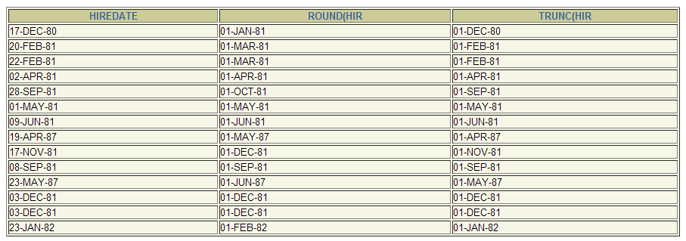
Date Function
ROUND and TRUNC
SELECT hiredate, ROUND(hiredate,’MONTH’),
TRUNC(hiredate,’MONTH’)
FROM emp;

Slide 52
Conversion Functions
Data type
conversion
Implicit data type
conversion
Explicit data type
conversion
Notes:
Conversion Functions
In addition to Oracle data types, columns of tables in an Oracle9i database can be defined using ANSI, DB2, and SQL/DS data types. However, the Oracle server internally converts such data types to Oracle data types.
In some cases, Oracle server uses data of one data type where it expects data of a different data type. When this happens, Oracle server can automatically convert the data to the expected data type. This data type conversion can be done implicitly by Oracle server, or explicitly by the user.
Implicit data type conversions work according to the rules explained in the next two slides.
Explicit data type conversions are done by using the conversion functions. Conversion functions convert a value from one data type to another. Generally, the form of the function names follows the convention data type TO data type. The first data type is the input data type; the last data type is the output.
Note: Although implicit data type conversion is available, it is recommended that you do explicit data type conversion to ensure the reliability of your SQL statements.

Slide 53
Implicit Data Type Conversion
For assignments, the Oracle server can automatically
convert the following:
From
To
VARCHAR2 or CHAR
NUMBER
VARCHAR2 or CHAR
DATE
NUMBER
VARCHAR2
DATE
VARCHAR2
Notes:
Implicit Data Type Conversion
The assignment succeeds if the Oracle server can convert the data type of the value used in the assignment to that of the assignment target.
Instructor Note
There are several new data types available in the Oracle9i release pertaining to time. These include: TIMESTAMP, TIMESTAMP WITH TIME ZONE, TIMESTAMP WITH LOCAL TIME ZONE, INTERVAL YEAR, INTERVAL DAY. These are discussed later in the course.
You can also refer students to the Oracle9i SQL Reference, “Basic Elements of Oracle SQL.”

Slide 54
Implicit Data Type Conversion
For expression evaluation, the Oracle Server can
automatically convert the following:
From
To
VARCHAR2 or CHAR
NUMBER
VARCHAR2 or CHAR
DATE
Notes:
Implicit Data Type Conversion (continued)
In general, the Oracle server uses the rule for expressions when a data type conversion is needed in places not covered by a rule for assignment conversions.
Note: CHAR to NUMBER conversions succeed only if the character string represents a valid number.
Instructor Note
Implicit data conversion is not solely performed on the data types mentioned. Other implicit data conversions can also be done. For example, VARCHAR2 can be implicitly converted to ROWID.

Slide 55
Explicit Data Type Conversion
TO_NUMBER
TO_DATE
NUMBER
CHARACTER
DATE
TO_CHAR
TO_CHAR
Notes:
Explicit Data Type Conversion
SQL provides three functions to convert a value from one data type to another:

Slide 56
Using the TO_CHAR Function with Dates
TO_CHAR(date, 'format_model')
The format model:
Must be enclosed in single quotation marks and is case sensitive
Can include any valid date format element
Has an fm element to remove padded blanks or suppress leading zeros
Is separated from the date value by a comma
Notes:
Displaying a Date in a Specific Format
Previously, all Oracle date values were displayed in the DD-MON-YY format. You can use the TO_CHAR function to convert a date from this default format to one specified by you.
Guidelines
The format model must be enclosed in single quotation marks and is case sensitive.
The format model can include any valid date format element. Be sure to separate the date value from the format model by a comma.
The names of days and months in the output are automatically padded with blanks.
To remove padded blanks or to suppress leading zeros, use the fill mode fm element.
You can format the resulting character field with the iSQL*Plus COLUMN command covered in a later lesson.
SELECT employee_id, TO_CHAR(hire_date, 'MM/YY') Month_Hired
FROM employees
WHERE last_name = 'Higgins';

Slide 57
Elements of the Date Format Model
YYYY
Full year in numbers
YEAR
Year spelled out
MM
Two-digit value for month
MONTH
Full name of the month
Three-letter abbreviation of the month
MON
Three-letter abbreviation of the day of the week
DY
DAY
Full name of the day of the week
DD
Numeric day of the month

Slide 58
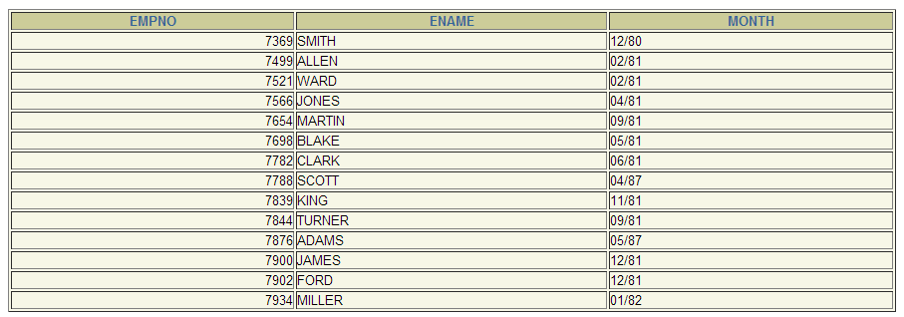
TO_CHAR Function
MM/YY Format
SELECT empno, ename,
TO_CHAR(hiredate, ‘MM/YY’) Month
FROM emp;

Slide 59
Date Format Elements
Elements | Description
SCC or CC | Century
YYYY or SYYYY | Year
YYY or YY or Y | Last 3, 2, 1 digit of the year
Y,YYY | Year with comma in this position
SYEAR or YEAR | Year spelled out
BC or AD | BC/AD indicator
B.C. or A.D. | BC/AD indicator w/ period
Q | Quarter of year
MM | Month; 2-digit value
MONTH | Name of month
MON | Name of month; 3-letter abbreviation
RM | Roman numeral month
WW or W | Week of the year or month
DDD or DD or D | Day of year, month, or week
DAY | Name of day
DY | Name of day; 3-letter abbreviation
J | Julian day

Slide 60
Elements of the Date Format Model
Time elements format the time portion of the date.
Add character strings by enclosing them in double quotation marks.
Number suffixes spell out numbers.
HH24:MI:SS AM
15:45:32 PM
DD "of" MONTH
12 of OCTOBER
ddspth
fourteenth
Notes:
Date Format Elements - Time Formats
Use the formats listed in the following tables to display time information and literals and to change numerals to spelled numbers.

Slide 61
Time Format Elements
Elements | Description
AM or PM | Meridian indicator
A.M. or P.M. | Meridian indicator w/ periods
HH or HH12 or HH24 | Hour of day, hour(1-12), or hour(0-23)
MI | Minute(0-59)
SS | Second(0-59)
Notes:
Other Formats
Specifying Suffixes to Influence Number Display

Slide 62
Suffixes Format Elements
Elements | Description
TH | Ordinal Number (DDTH = 4th)
SP | Spelled-out (DDSP = FOUR)
SPTH or THSP | Spelled-out ordinal numbers (DDSPTH = FOURTH)
Notes:
Other Formats
Specifying Suffixes to Influence Number Display

Slide 63
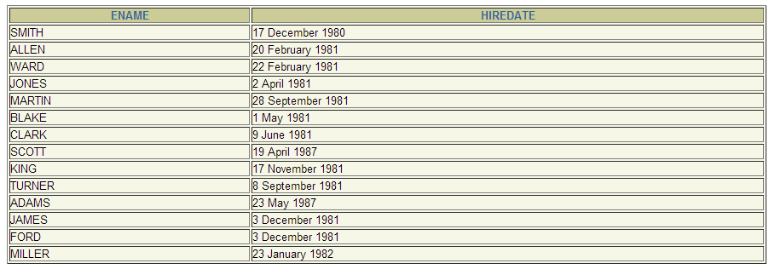
Using the TO_CHAR Function with Dates
SELECT ename,
TO_CHAR(hiredate, 'fmDD Month YYYY')
AS HIREDATE
FROM emp;
Notes:
The TO_CHAR Function with Dates
The SQL statement on the slide displays the last names and hire dates for all the employees. The hire date appears as 17 June 1987.
Example
Modify the slide example to display the dates in a format that appears as Seventh of June 1994 12:00:00 AM.
SELECT last_name,
TO_CHAR(hire_date,
'fmDdspth "of" Month YYYY fmHH:MI:SS AM')
HIREDATE
FROM employees;
Notice that the month follows the format model specified: in other words, the first letter is capitalized and the rest are lowercase.
…

Slide 64
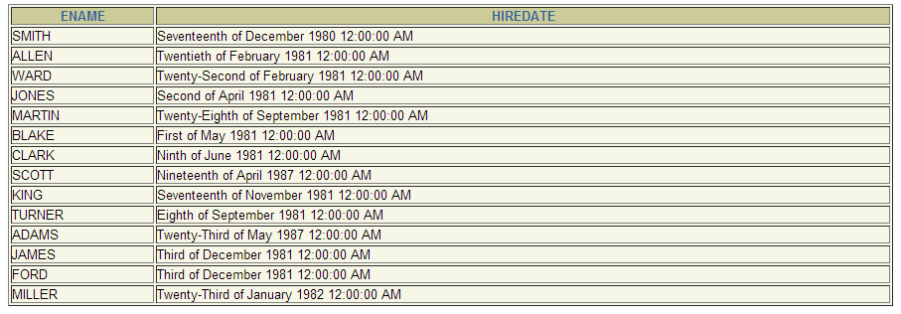
Using the TO_CHAR Function with Dates
SELECT ename,
TO_CHAR(hiredate, 'fmDdspth “of” Month YYYY
fmHH:MI:SS AM')
AS HIREDATE
FROM emp;
Notes:
The TO_CHAR Function with Dates
The SQL statement on the slide displays the last names and hire dates for all the employees. The hire date appears as 17 June 1987.
Example
Modify the slide example to display the dates in a format that appears as Seventh of June 1994 12:00:00 AM.
SELECT last_name,
TO_CHAR(hire_date,
'fmDdspth "of" Month YYYY fmHH:MI:SS AM')
HIREDATE
FROM employees;
Notice that the month follows the format model specified: in other words, the first letter is capitalized and the rest are lowercase.
…

Slide 65
Using the TO_CHAR Function with Numbers
TO_CHAR(number, 'format_model')
These are some of the format elements you can use with the TO_CHAR function to display a number value as a character:
9
Represents a number
0
Forces a zero to be displayed
$
Places a floating dollar sign
L
Uses the floating local currency symbol
.
Prints a decimal point
,
Prints a thousand indicator
Notes:
The TO_CHAR Function with Numbers
When working with number values such as character strings, you should convert those numbers to the character data type using the TO_CHAR function, which translates a value of NUMBER data type to VARCHAR2 data type. This technique is especially useful with concatenation.
Number Format Elements
If you are converting a number to the character data type, you can use the following format elements:

Slide 66
Number Format Elements
Element | Description | Example | Result
9 | Numeric Position | 999999 | 1234
0 | Display Leading Zeros | 099999 | 001234
$ | Floating Dollar sign | $9999999 | $1234
L | Floating Local Currency symbol | L999999 | FF1234
. | Decimal Point in position specified | 999999.99 | 1234.00
, | Comma in position specified | 999,999 | 1,234
MI | Minus signs to right | 999999MI | 1234-
PR | Parenthesize negative numbers | 999999PR | <1234>
EEEE | Scientific notation | 99.999EEEE | 1.234E+03

Slide 67
Using the TO_CHAR Function with Numbers
SELECT TO_CHAR(sal, '$99,999.00') SALARY
FROM emp
WHERE ename = ‘KING';
Notes:
Guidelines
The Oracle server displays a string of hash signs (#) in place of a whole number whose digits exceed the number of digits provided in the format model.
The Oracle server rounds the stored decimal value to the number of decimal spaces provided in the format model.
Instructor Note (for page 3-39)
You can demonstrate the code using the fx modifier in the file 3_39n. Run the file with the fx modifier present, then remove the fx modifier and run the statement again.

Slide 68
Using the TO_NUMBER and TO_DATE Functions
Convert a character string to a number format using the TO_NUMBER function:
Convert a character string to a date format using the TO_DATE function:
TO_NUMBER(char[, 'format_model'])
TO_DATE(char[, 'format_model'])
Notes:
The TO_NUMBER and TO_DATE Functions
You may want to convert a character string to either a number or a date. To accomplish this task, use the TO_NUMBER or TO_DATE functions. The format model you choose is based on the previously demonstrated format elements.
The “fx” modifier specifies exact matching for the character argument and date format model of a TO_DATE function:
Punctuation and quoted text in the character argument must exactly match (except for case) the corresponding parts of the format model.
The character argument cannot have extra blanks. Without fx, Oracle ignores extra blanks.
Numeric data in the character argument must have the same number of digits as the corresponding element in the format model. Without fx, numbers in the character argument can omit leading zeroes.

Slide 69
RR Date Format
Current Year
1995
1995
2001
2001
Specified Date
27-OCT-95
27-OCT-17
27-OCT-17
27-OCT-95
RR Format
1995
2017
2017
1995
YY Format
1995
1917
2017
2095
If the specified two-digit year is:
0–49
50–99
If two digits of the current
year are:
The return date is in the current century
The return date is in the century before the current one
0–49
The return date is in the century after the current one
The return date is in the current century
50–99
Notes:
The RR Date Format Element
The RR date format is similar to the YY element, but you can use it to specify different centuries. You can use the RR date format element instead of YY, so that the century of the return value varies according to the specified two-digit year and the last two digits of the current year. The table on the slide summarizes the behavior of the RR element.
Instructor Note
RR is available in Oracle7, not Oracle version 6. NLS parameters can be added to the init.ora file to set default date formats and language names and abbreviations. For more information, see Oracle9i SQL Reference, “ALTER SESSION”.
Demo: 3_hire.sql
Purpose: To illustrate date format model elements.

Slide 70

Example of RR Date Format
To find employees hired prior to 1990, use the RR
format, which produces the same results whether the
command is run in 1999 or now:
SELECT last_name, TO_CHAR(hire_date, 'DD-Mon-YYYY')
FROM employees
WHERE hire_date < TO_DATE('01-Jan-90', 'DD-Mon-RR');
Notes:
The RR Date Format Element Example
To find employees who were hired prior to 1990, the RR format can be used. Since the year is now greater than 1999, the RR format interprets the year portion of the date from 1950 to 1999.
The following command, on the other hand, results in no rows being selected because the YY format interprets the year portion of the date in the current century (2090).
SELECT last_name, TO_CHAR(hire_date, 'DD-Mon-yyyy')
FROM employees
WHERE TO_DATE(hire_date, 'DD-Mon-yy') < '01-Jan-1990';
no rows selected

Slide 71
Nesting Functions
Single-row functions can be nested to any level.
Nested functions are evaluated from deepest level to the least deep level.
F3(F2(F1(col,arg1),arg2),arg3)
Step 1 = Result 1
Step 2 = Result 2
Step 3 = Result 3
Notes:
Nesting Functions
Single-row functions can be nested to any depth. Nested functions are evaluated from the innermost level to the outermost level. Some examples follow to show you the flexibility of these functions.

Slide 72
Nesting Functions
SELECT last_name,
NVL(TO_CHAR(manager_id), 'No Manager')
FROM employees
WHERE manager_id IS NULL;
Notes:
Nesting Functions (continued)
The slide example displays the head of the company, who has no manager. The evaluation of the SQL statement involves two steps:
1. Evaluate the inner function to convert a number value to a character string.
Result1 = TO_CHAR(manager_id)
2. Evaluate the outer function to replace the null value with a text string.
NVL(Result1, 'No Manager')
The entire expression becomes the column heading because no column alias was given.
Example
Display the date of the next Friday that is six months from the hire date. The resulting date should appear as Friday, August 13th, 1999. Order the results by hire date.
SELECT TO_CHAR(NEXT_DAY(ADD_MONTHS
(hire_date, 6), 'FRIDAY'),
'fmDay, Month DDth, YYYY')
"Next 6 Month Review"
FROM employees
ORDER BY hire_date;
Instructor Note
Demo: 3_nest.sql
Purpose: To illustrate nesting of several single row functions

Slide 73
Nesting Functions
SELECT TO_CHAR(NEXT_DAY(ADD_MONTHS(hiredate,6),
‘FRIDAY’),’fmDay, Month DDth, YYYY’)
“NEXT 6 MONTH REVIEW”
FROM emp
ORDER BY hiredate;
Notes:
Nesting Functions (continued)
The slide example displays the head of the company, who has no manager. The evaluation of the SQL statement involves two steps:
1. Evaluate the inner function to convert a number value to a character string.
Result1 = TO_CHAR(manager_id)
2. Evaluate the outer function to replace the null value with a text string.
NVL(Result1, 'No Manager')
The entire expression becomes the column heading because no column alias was given.
Example
Display the date of the next Friday that is six months from the hire date. The resulting date should appear as Friday, August 13th, 1999. Order the results by hire date.
SELECT TO_CHAR(NEXT_DAY(ADD_MONTHS
(hire_date, 6), 'FRIDAY'),
'fmDay, Month DDth, YYYY')
"Next 6 Month Review"
FROM employees
ORDER BY hire_date;
Instructor Note
Demo: 3_nest.sql
Purpose: To illustrate nesting of several single row functions

Slide 74
Practice 3, Part One: Overview
This practice covers the following topics:
Writing a query that displays the current date
Creating queries that require the use of numeric, character, and date functions
Performing calculations of years and months of service for an employee
Notes:
Practice 3, Part One: Overview
This practice is designed to give you a variety of exercises using different functions available for character, number, and date data types.
Complete questions 1-5 at the end of this lesson.

Slide 75
Exercise #1
Display the employee number, name salary, and salary increased by 15% and expressed as whole number. Label the column New Salary. Then subtract the old salary from the new salary and label the column increase.

Slide 76
Exercise #2
Write a query that will display the employee’s name concatenated with his job. The first letter of his name and job should be capitalized and all other letters are in lowercase. Show the length of the string in a new column.

Slide 77
Exercise #3
Display the employees name, and calculate the number of months between today and the date the employee was hired. Label the column MONTH_WORKED. Order your results by the number of months employed. Round the number of months up to the closest whole number.

Slide 78
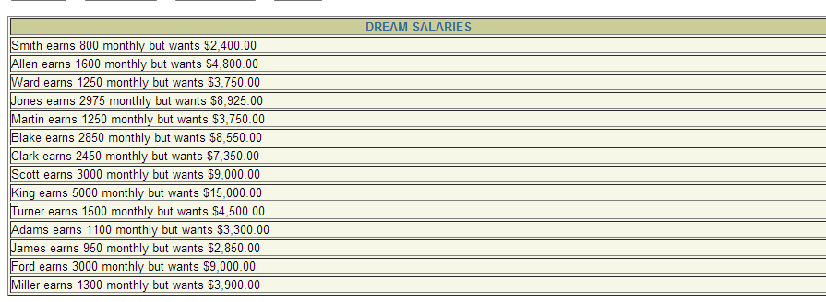
Exercise #4
Write a query that produce the following in a single column:
<employee name> earns <salary> monthly but wants <three times of his salary>
Label the column DREAM SALARIES.

Slide 79
Exercise #5
Create a query to display the last name and salary for all employees. Format the salary to be 15 characters long, left-padded with $. Label the column SALARY.

Slide 80
Exercise #6
Display the employee name, hiredate, and salary review date, which is the first Monday after six months of service. Label the column REVIEW. Format the dates to appear in the format similar to “Monday, the Thirty-First of July, 2000”

Slide 81
Exercise #7
Display the name, hiredate, and the day of the week on which the employee started. Label the column DAY. Order the results by the day of the week starting with Monday.

Slide 82
General Functions
These functions work with any data type and pertain
to using nulls.
NVL (expr1, expr2)
NVL2 (expr1, expr2, expr3)
NULLIF (expr1, expr2)
COALESCE (expr1, expr2, ..., exprn)
Notes:
General Functions
These functions work with any data type and pertain to the use of null values in the expression list.
Note: For more information on the hundreds of functions available, see Oracle9i SQL Reference, “Functions.”

Slide 83
NVL Function
Converts a null to an actual value.
Data types that can be used are date, character, and number.
Data types must match:
  NVL(comm,0)
  NVL(hiredate,'01-JAN-97')
  NVL(job,'No Job Yet')
Notes:
The NVL Function
To convert a null value to an actual value, use the NVL function.
Syntax
NVL (expr1, expr2)
In the syntax:
expr1 is the source value or expression that may contain a null
expr2 is the target value for converting the null
You can use the NVL function to convert any data type, but the return value is always the same as the data type of expr1.
NVL Conversions for Various Data Types

Slide 84
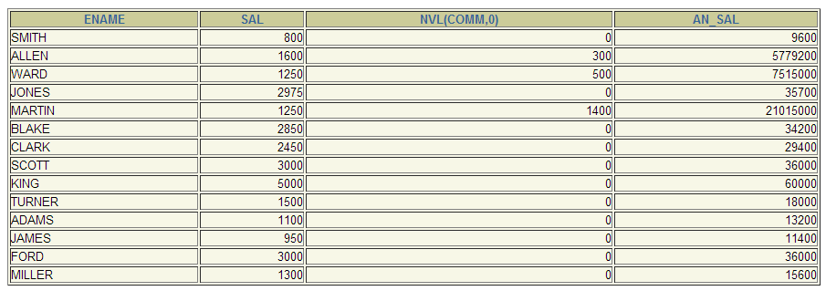
Using the NVL Function
SELECT ename, sal, NVL(comm, 0),
(sal*12) + (sal*12*NVL(comm, 0)) AN_SAL
FROM emp;
Notes:
The NVL Function
To calculate the annual compensation of all employees, you need to multiply the monthly salary by 12 and then add the commission percentage to it.
SELECT last_name, salary, commission_pct,
(salary*12) + (salary*12*commission_pct) AN_SAL
FROM employees;
Notice that the annual compensation is calculated only for those employees who earn a commission. If any column value in an expression is null, the result is null. To calculate values for all employees, you must convert the null value to a number before applying the arithmetic operator. In the example on the slide, the NVL function is used to convert null values to zero.
…
…

Slide 85
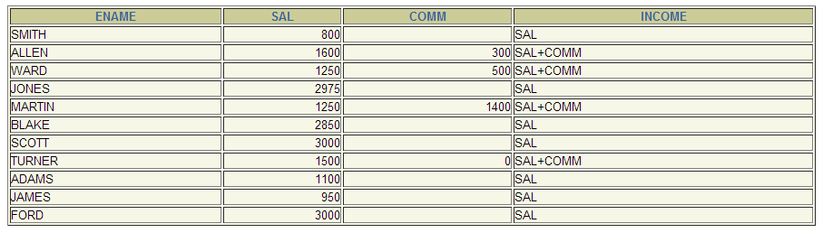
Using the NVL2 Function
SELECT ename, sal, comm,
NVL2(comm,
'SAL+COMM', 'SAL') income
FROM emp WHERE deptno IN (20, 30);
Notes:
The NVL2 Function
The NVL2 function examines the first expression. If the first expression is not null, then the NVL2 function returns the second expression. If the first expression is null, then the third expression is returned.
Syntax
NVL(expr1, expr2, expr3)
In the syntax:
expr1 is the source value or expression that may contain null
expr2 is the value returned if expr1 is not null
expr3 is the value returned if expr2 is null
In the example shown, the COMMISSION_PCT column is examined. If a value is detected, the second expression of SAL+COMM is returned. If the COMMISSION_PCT column holds a null values, the third expression of SAL is returned.
The argument expr1 can have any data type. The arguments expr2 and expr3 can have any data types except LONG. If the data types of expr2 and expr3 are different, The Oracle server converts expr3 to the data type of expr2 before comparing them unless expr3 is a null constant. In that case, a data type conversion is not necessary.
The data type of the return value is always the same as the data type of expr2, unless expr2 is character data, in which case the return value’s data type is VARCHAR2.

Slide 86
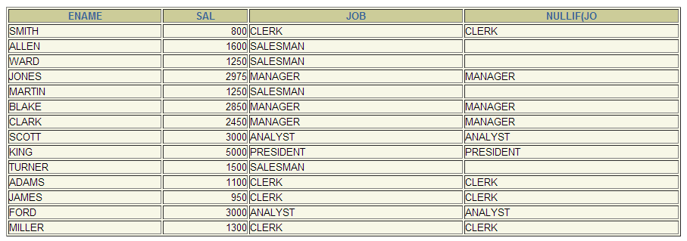
Using the NULLIF Function
SELECT ename, sal, job,
NULLIF(job,'SALESMAN')
FROM emp;
Notes:
The NULLIF Function
The NULLIF function compares two expressions. If they are equal, the function returns null. If they are not equal, the function returns the first expression. You cannot specify the literal NULL for first expression.
Syntax
NULLIF (expr1, expr2)
In the syntax:
expr1 is the source value compared to expr2
expr2 is the source value compared with expr1. (If it is not equal to expr1, expr1 is returned.)
In the example shown, the job ID in the EMPLOYEES table is compared to the job ID in the JOB_HISTORY table for any employee who is in both tables. The output shows the employee’s current job. If the employee is listed more than once, that means the employee has held at least two jobs previously.
Note: The NULLIF function is logically equivalent to the following CASE expression. The CASE expression is discussed in a subsequent page:
CASE WHEN expr1 = expr 2 THEN NULL ELSE expr1 END

Slide 87
Summary
In this lesson, you should have learned how to:
Perform calculations on data using functions
Modify individual data items using functions
Manipulate output for groups of rows using functions
Alter date formats for display using functions
Convert column data types using functions
Use NVL functions
Use IF-THEN-ELSE logic
Notes:
Single-Row Functions
Single-row functions can be nested to any level. Single-row functions can manipulate the following:
Character data: LOWER, UPPER, INITCAP, CONCAT, SUBSTR, INSTR, LENGTH
Number data: ROUND, TRUNC, MOD
Date data: MONTHS_BETWEEN, ADD_MONTHS, NEXT_DAY, LAST_DAY, ROUND, TRUNC
Date values can also use arithmetic operators.
Conversion functions can convert character, date, and numeric values: TO_CHAR, TO_DATE, TO_NUMBER
There are several functions that pertain to nulls, including NVL, NVL2, NULLIF, and COALESCE.
IF-THEN-ELSE logic can be applied within a SQL statement by using the CASE expression or the DECODE function.
SYSDATE and DUAL
SYSDATE is a date function that returns the current date and time. It is customary to select SYSDATE from a dummy table called DUAL.

Slide 88
Practice 3, Part Two: Overview
This practice covers the following topics:
Creating queries that require the use of numeric, character, and date functions
Using concatenation with functions
Writing case-insensitive queries to test the usefulness of character functions
Performing calculations of years and months of service for an employee
Determining the review date for an employee
Notes:
Practice 3, Part Two: Overview
This practice is designed to give you a variety of exercises using different functions available for character, number, and date data types.
Remember that for nested functions, the results are evaluated from the innermost function to the outermost function.
Instructor Note
This practice should be done in two parts. Part 1 contains questions 1-5 which cover the material from pages 1-23. Part 2 contains questions 6-14 and matches the material for the remainder of the lesson.
Practice question 6: Be sure to tell the students that their results may differ from the one provided, because SYSDATE is used in the exercise.
Instructor hint for practice question 10: The ORDER BY clause in the solution sorts on TO_CHAR(hiredate-1, 'd'). The format element ‘d’ returns a ‘1’ for Sunday, ‘2’ for Monday, and so forth. The expression hiredate-1 effectively “shifts” each hiredate to the previous day, so that an employee hired on a Monday appears to have been hired on Sunday. The TO_CHAR function returns a ‘1’ for that employee and the result set is sorted beginning with those employees hired on Monday.

Slide 89
Exercise #1
Create a query that will display the employees’ names and commission amounts. If an employee does not earn commission, put “No Commission”. Label the column COMM.

Slide 90
Exercise #2
Create a query that will display the employees’ names and salaries with PHP as its prefix.
Nested Function is required for this.
  LENGTH, LPAD, and TO_CHAR
Example
KING PHP 5,000.00

Slide 91
Exercise #3
Using DECODE function, write a query that displays the grade of all employees based on the value of the column JOB, as per the following data: GRADE:
PRESIDENT = A
MANAGER = B
ANALYST = C
SALESMAN = D
CLERK = E
None of the Above = 0

Slide 92
Exercise #4
Remake your query for exercise 3. Use the CASE syntax instead.

